Slide 1
Deepening understanding of multiplication with fractions
Arithmetic procedures with fractions

Slide 2
how to use Oak lessons

Slide 3
I can generalise and fluently use strategies to multiply with mixed numbers.

Slide 4
A product is the result of two or more numbers multiplied together.
A proper fraction is a fraction where the numerator is less than the denominator.
An improper fraction is a fraction where the numerator is greater than or equal to the denominator.
A mixed number is an improper fraction written as its integer part plus the fractional part where the fractional part is a proper fraction.

Slide 5

Deepening understanding of multiplication with fractions
Multiplying by a mixed number
Comparing strategies

Slide 6




Multiplying by a mixed number
What are the missing numbers?
+
12
+
12
+
= 12 ×
+
12
12
+
12
+
12 =
12 ×
12
3
4
3 × 12
What
is
× 12?
+
12
+
+
+
= 12 ×
12
+
12
+
12
12
12
4
6 = 12 ×
3 × 12
What fraction of 12 is 6?
What
is
× 12?

Slide 7
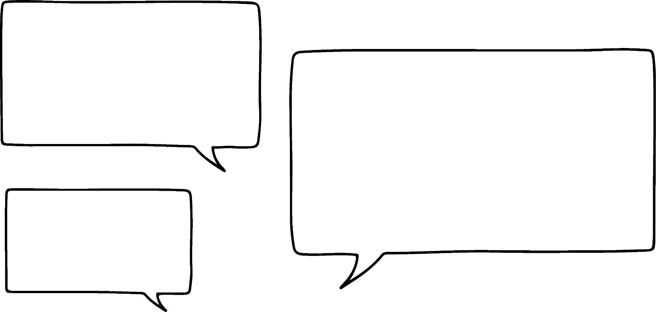
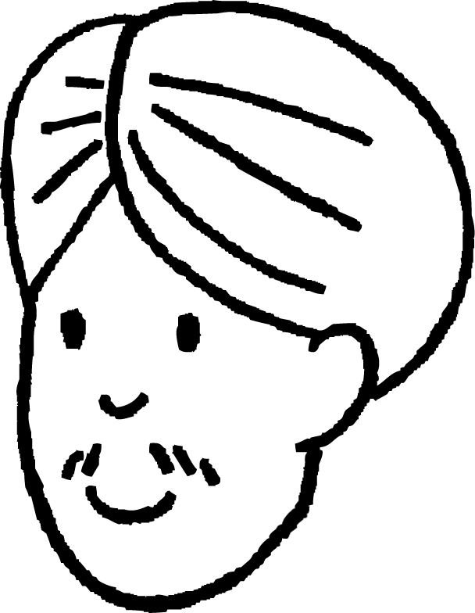
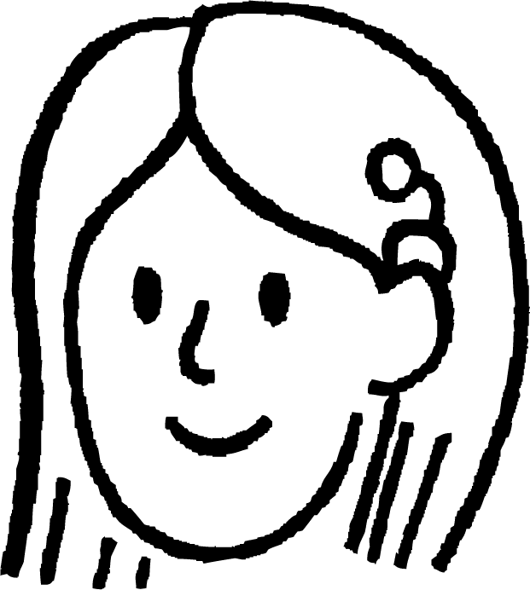
Multiplying by a mixed number
13 × 24
200
40
60
12
312
20
4
200 | 40
60 | 12
10
3
+
Can you please remind me what it looked like?
When we calculated something like this before we used the area model.
Oh yes, I remember now.
Andeep
Sofia

Slide 8
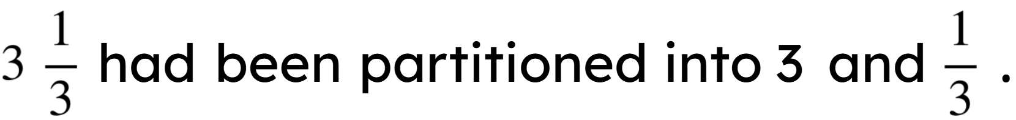
Multiplying by a mixed number
We will take another look at this question from earlier.
12
+
12
+
12
+
= 12 ×
4
3 × 12
× 12
Which could have been calculated as 3 × 10 + 3 × 2.

Slide 9
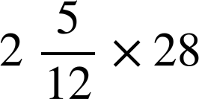
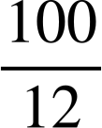

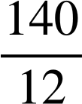

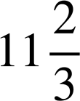
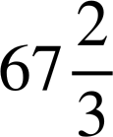
Multiplying by a mixed number
40
+
16
+
20
8
+
40 | 16
2
= 56 +
= 56 +
= 56 +
=
Do you think we could use the same method for this question?
I don’t see why not.
Andeep
Sofia

Slide 10
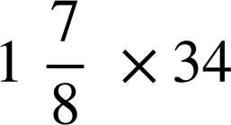
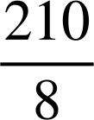

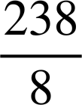
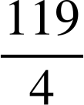
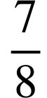
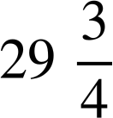
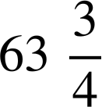
Multiplying by a mixed number
Calculate this product using the area model.
30
4
30 + 4 + +
30 | 4
1
= 34 +
= 34 +
=
= 34 +

Slide 11
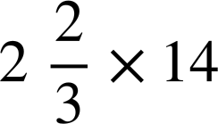







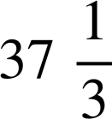
Multiplying by a mixed number
Spot and correct the mistakes in the method to calculate:
10
4
20
+
8
+
+
20 | 8
2
=
28
+
+
=
28
+
3
= 31
=

Slide 12
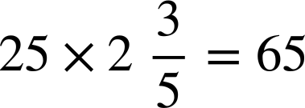
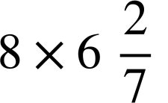
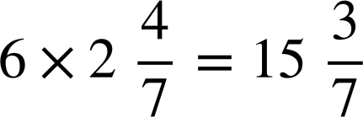
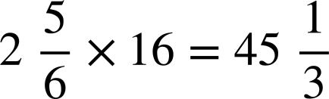
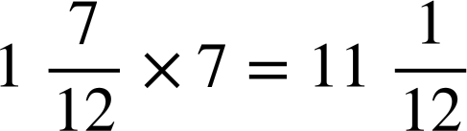
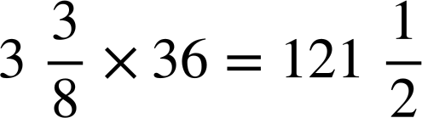
Multiplying by a mixed number
Calculate the answers to the following:
Give all answers in their simplest form.
a)
b)
c)
d)
e)
f)

Slide 13
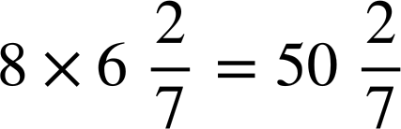
Multiplying by a mixed number
Calculate the answers to the following:
Give all answers in their simplest form.
a)
b)
c)
d)
e)
f)

Slide 14
Deepening understanding of multiplication with fractions
Multiplying by a mixed number
Comparing strategies

Slide 15
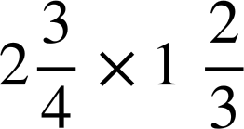
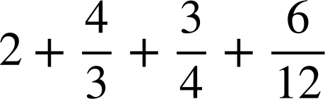

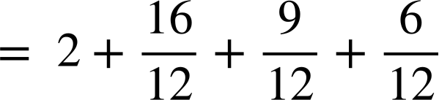

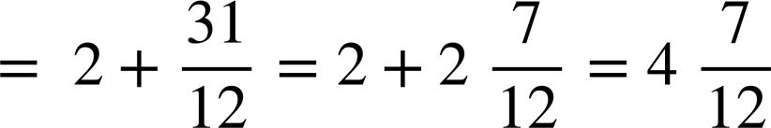
Comparing strategies
1
2
2
Can we use the area model with two mixed numbers?
Yes we can.
Andeep
Sofia

Slide 16
Comparing strategies
I’ve just thought if we can multiply proper fractions by multiplying the numerators together and the denominators together. Could we change these into improper fractions and do that?
Oh yes, of course we could. Let’s check that we get the same answer.
Andeep
Sofia

Slide 17
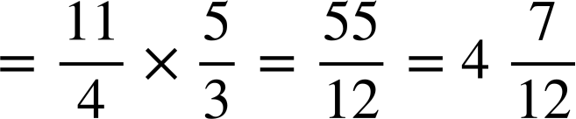
Comparing strategies
1
2
2
Which method do you prefer?

Slide 18
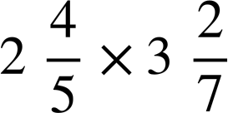
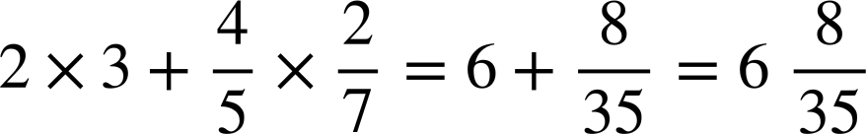
Comparing strategies
Sofia has decided that she doesn’t need to draw out the area model.
Here
are
her
workings
for
this
calculation:
Why will Sofia’s method not work?
She has not found the product of 3 and and 2 and .
Sofia

Slide 19
Comparing strategies
One disadvantage of converting mixed numbers to improper fractions is that you can end up with large numerators and denominators.
Remember that you can write the new numerators and denominators using factors to simplify before multiplying.
write as improper
fractions
write using factors
arrange common factors together
multiply
convert to a mixed number

Slide 20
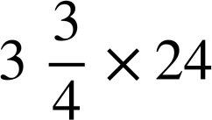
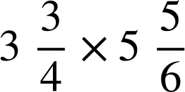
Comparing strategies
You can use any of the methods we have looked at.
Some may be more efficient in different situations.
E.g.
you might prefer to use the area model and partition
the
into
and
.
you might prefer to convert to improper fractions.

Slide 21
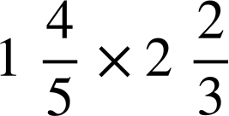
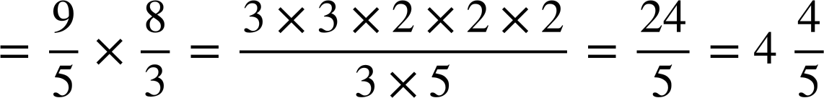
Comparing strategies
Calculate
Calculate

Slide 22
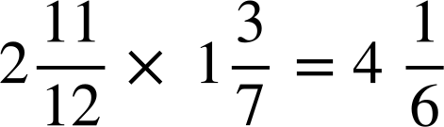
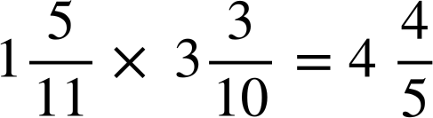
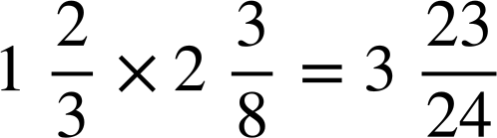
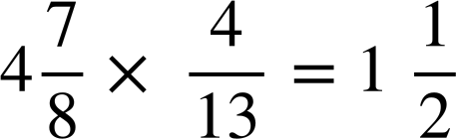
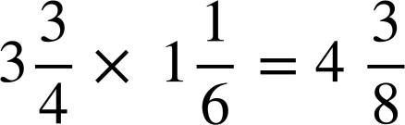
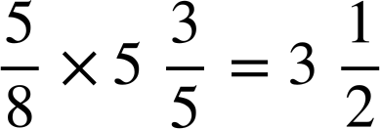
Comparing strategies
Calculate the following. Try to use the most efficient method.
a)
b)
c)
d)
e)
f)

Slide 23
Comparing strategies
Calculate the following. Try to use the most efficient method.
a)
b)
c)
d)
e)
f)

Slide 24
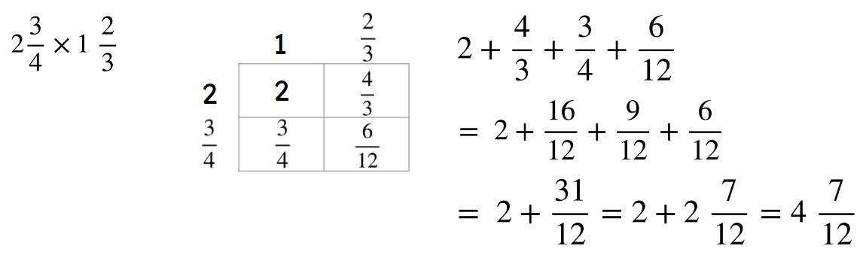
Deepening understanding of multiplication with fractions
The area model can be used to multiply mixed numbers.
E.g.
Mixed numbers can be multiplied by converting into improper fractions.
E.g.

Slide 25

© Oak National Academy 2023.
Produced in partnership with Mathematics in Education and Industry.
Licensed on the Open Government Licence v3.0, except where otherwise stated. See Oak terms and conditions.

